Slide 1
Assignment 4 - GAN
Take the code and change the generator and the discriminator architectures by introducing convolution layers. Use one of the classes from the CIFAR-10 dataset to generate images. Show the effect of controlling the noise vector.

Slide 2
Experiment Steps
Loading and Pre-processing Data
Building the Generator
Building the Discriminator
Training Loop
Saving and Loading Model Weights
Displaying Generated Images and Predictions
Conclusion
Notes:
Convolutional Neural Network (CNN): Upsampling and Convolutional Layers -> Batch Normalization and Activation Functions(Leaky ReLU and Dropout) -> Strided Convolution -> Reshaping(Flatten and Dense sigmoid activation)

Slide 3
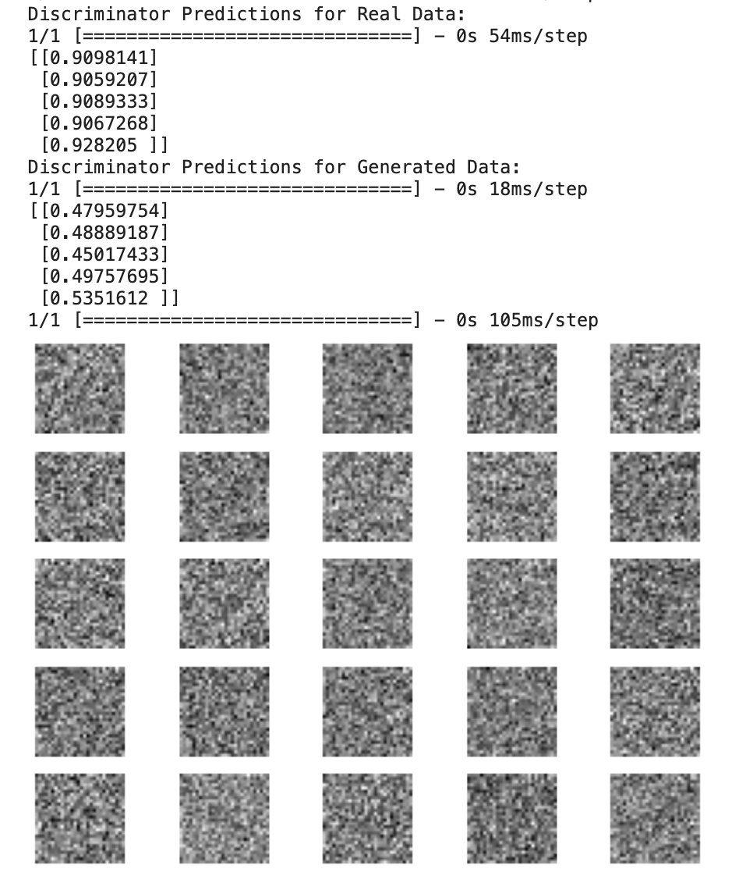
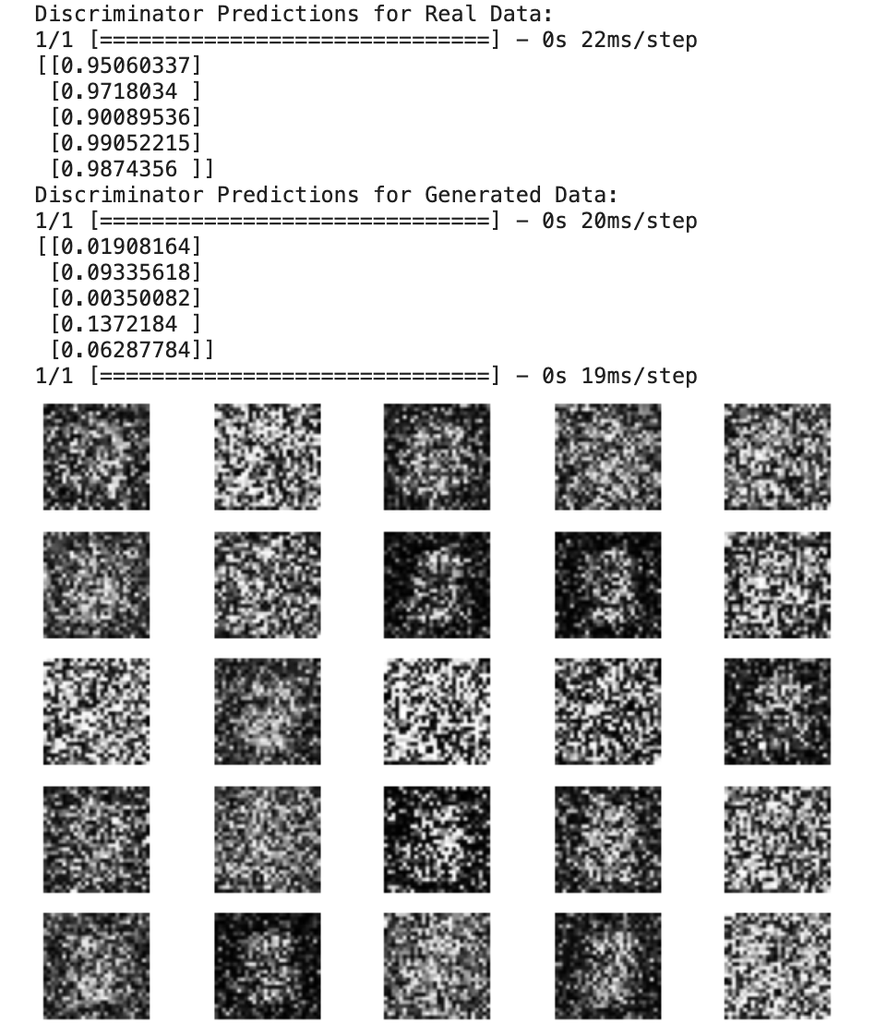

Slide 4
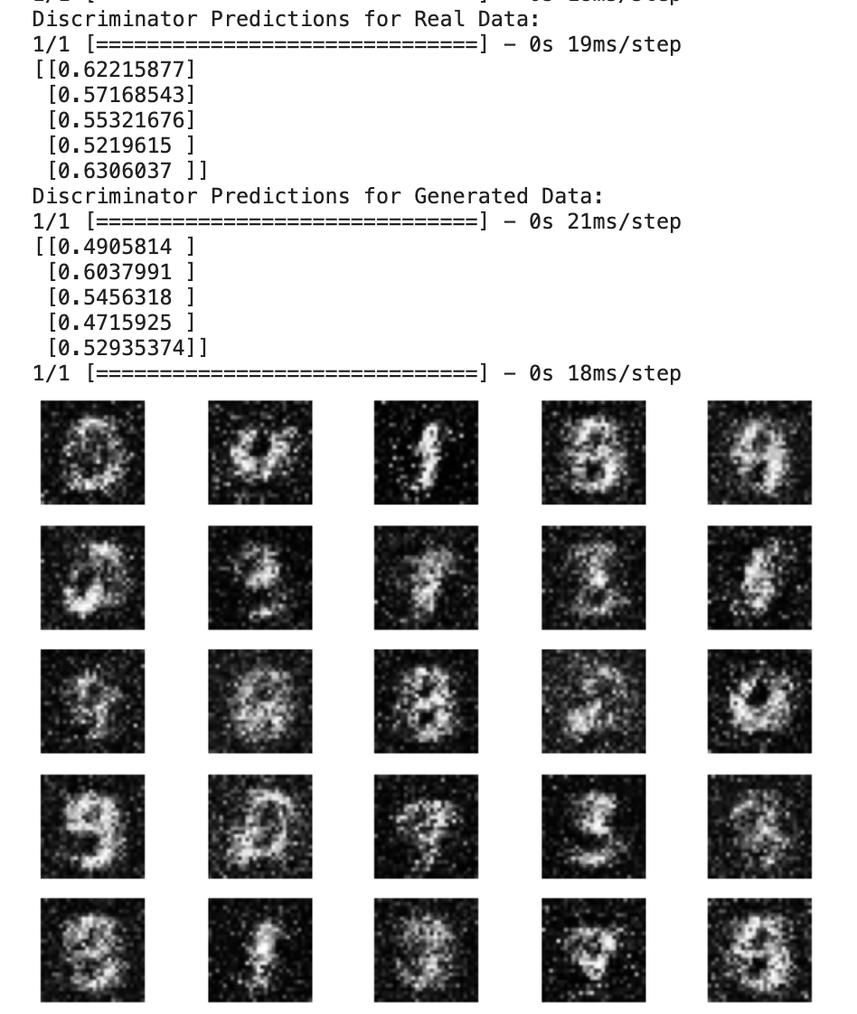
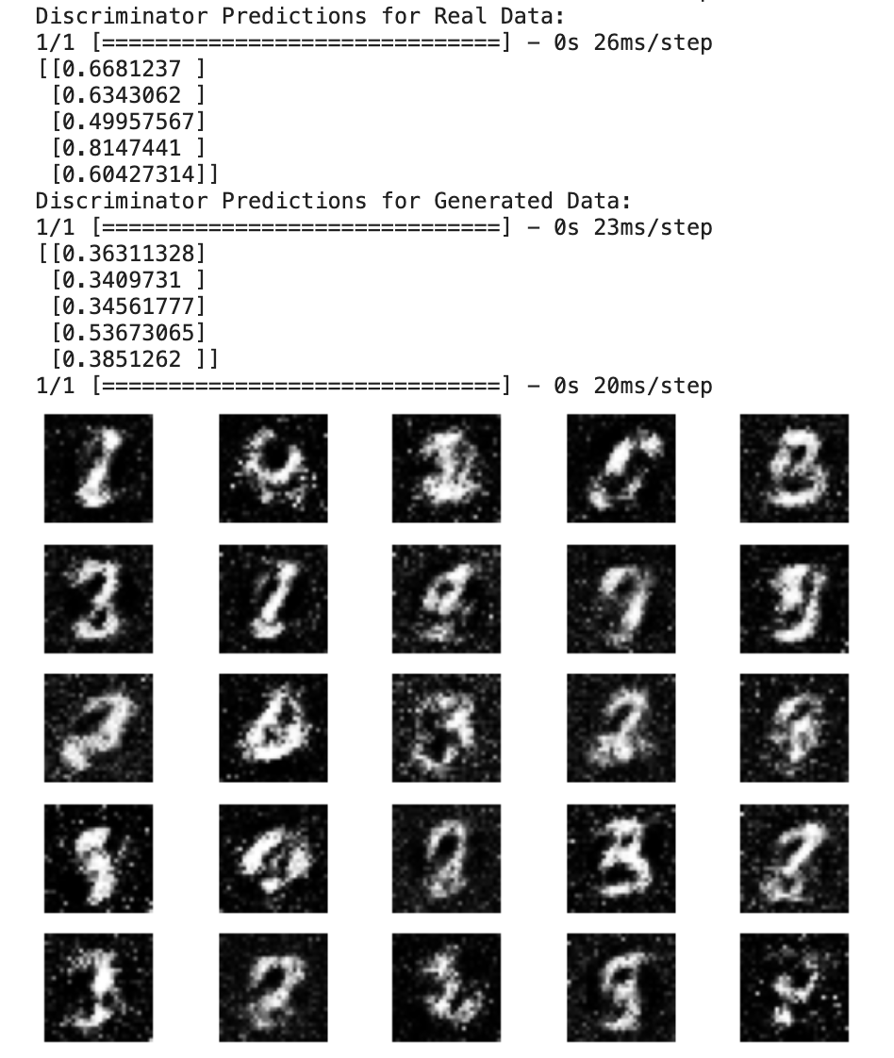

Slide 5
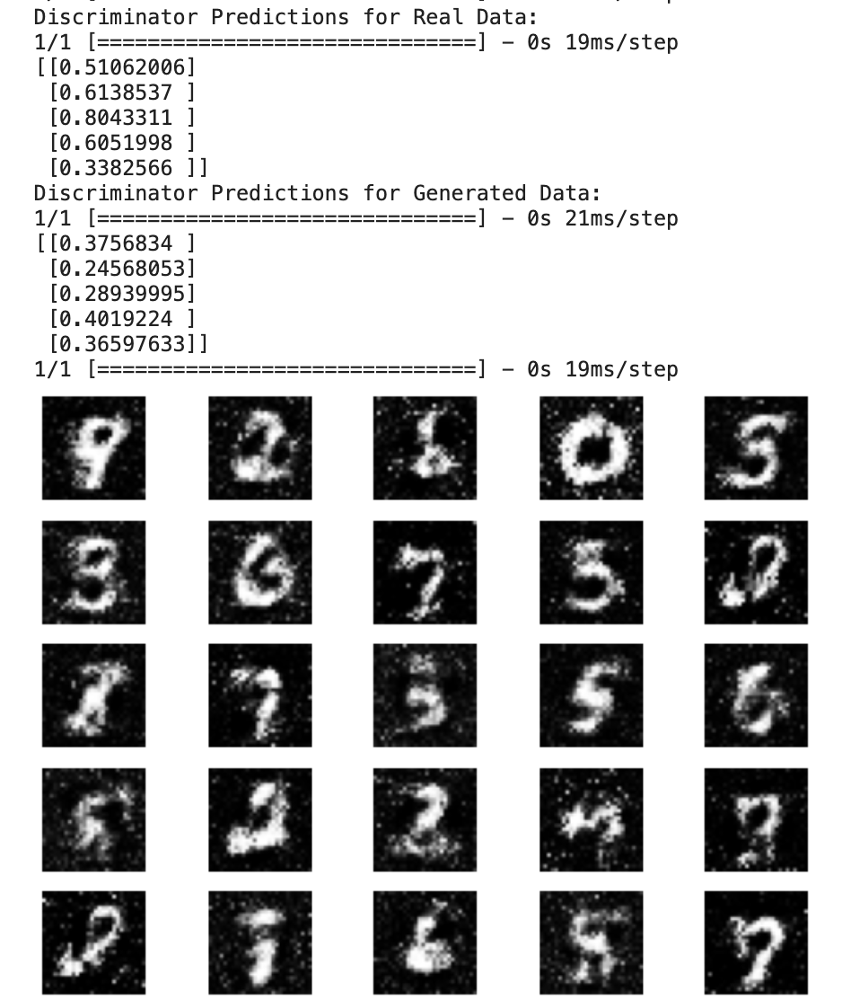
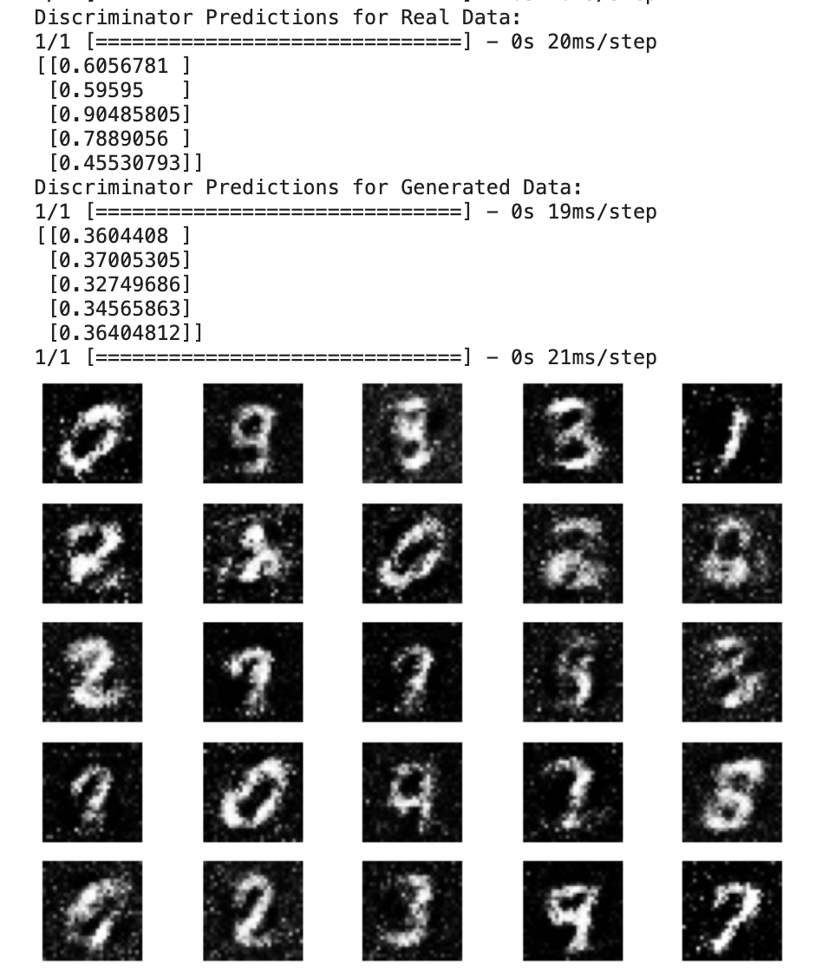

Slide 6
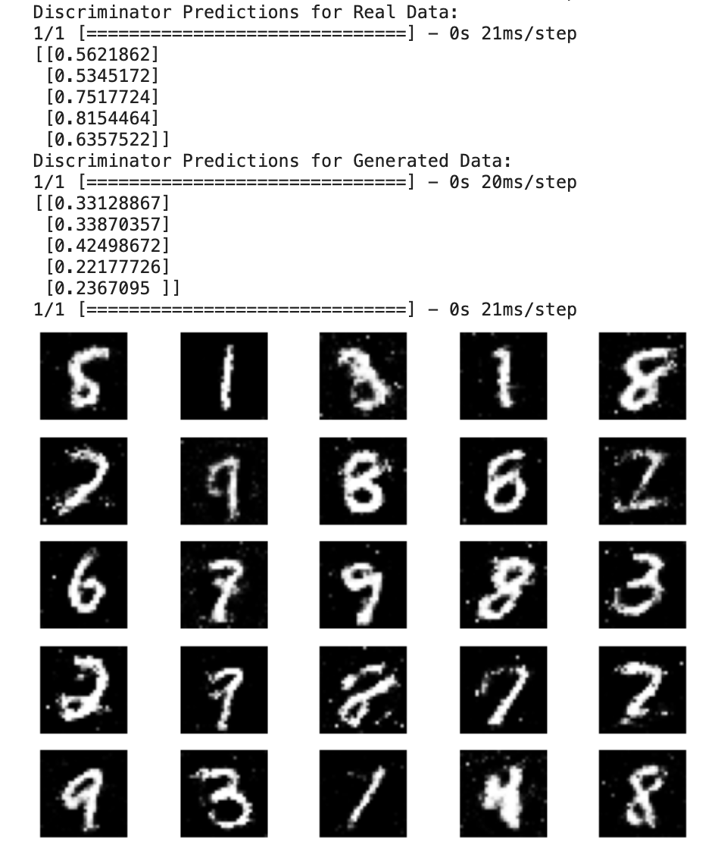
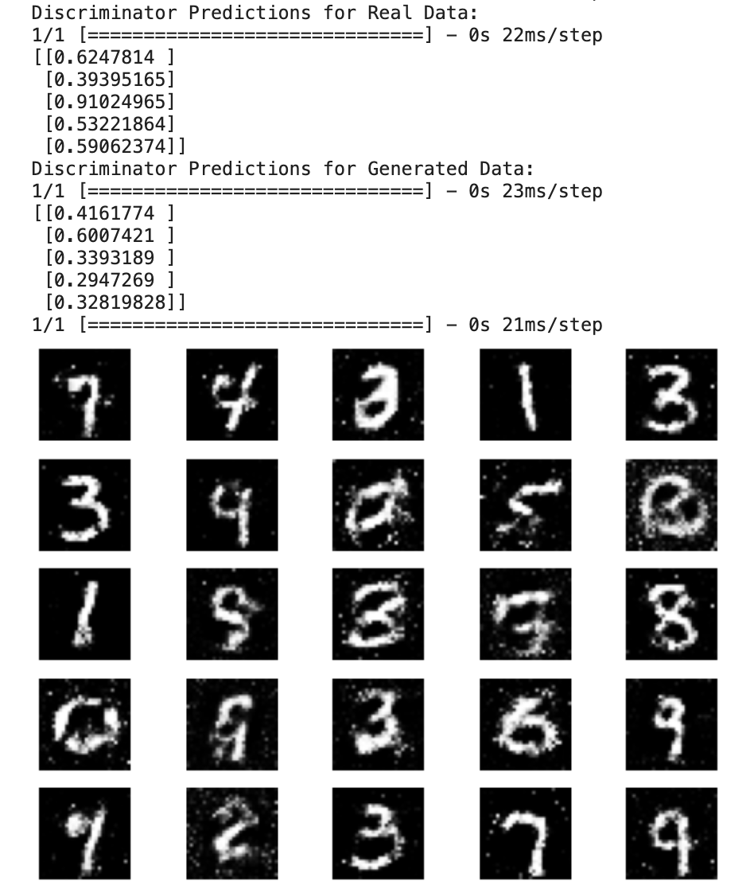

Slide 7
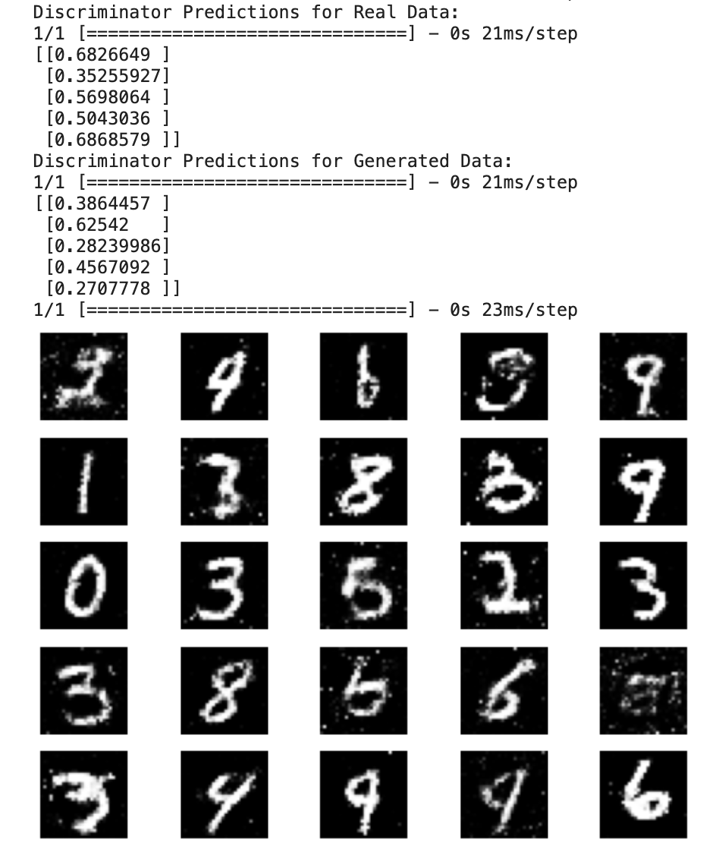
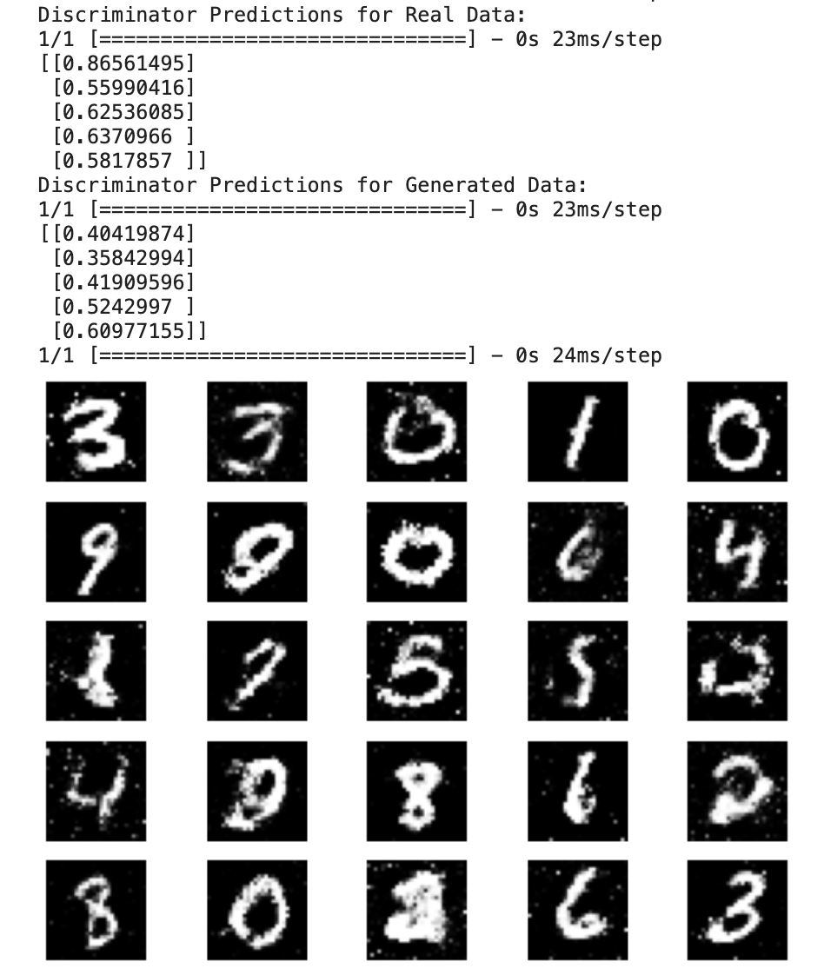

Slide 8
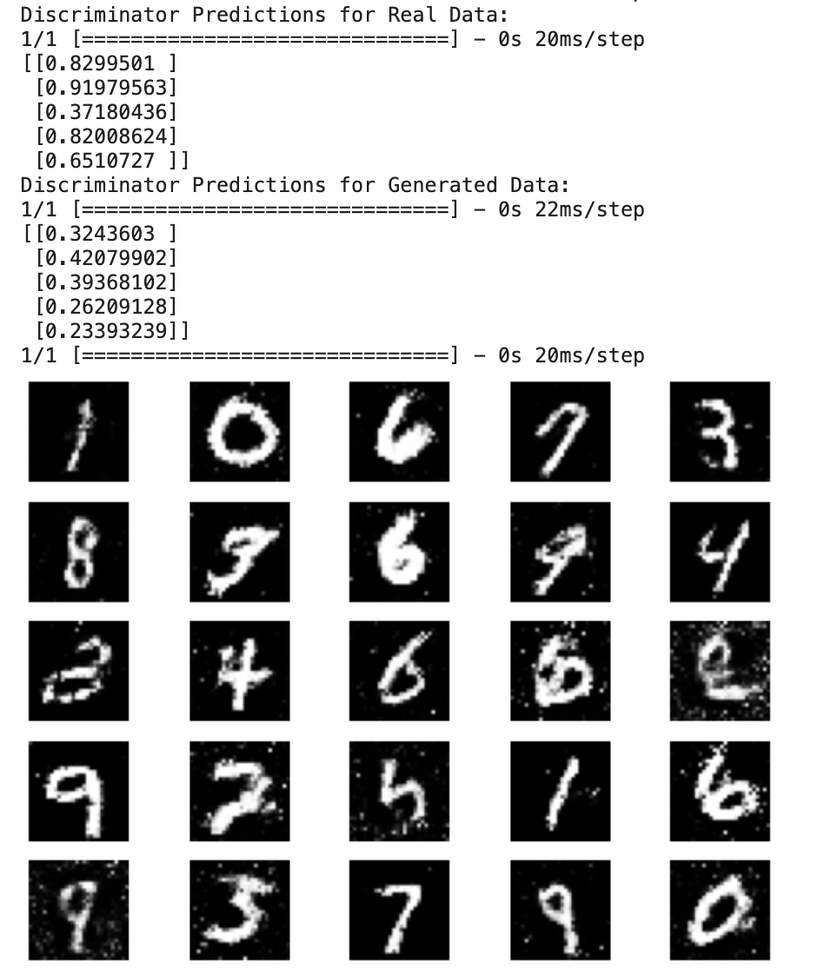
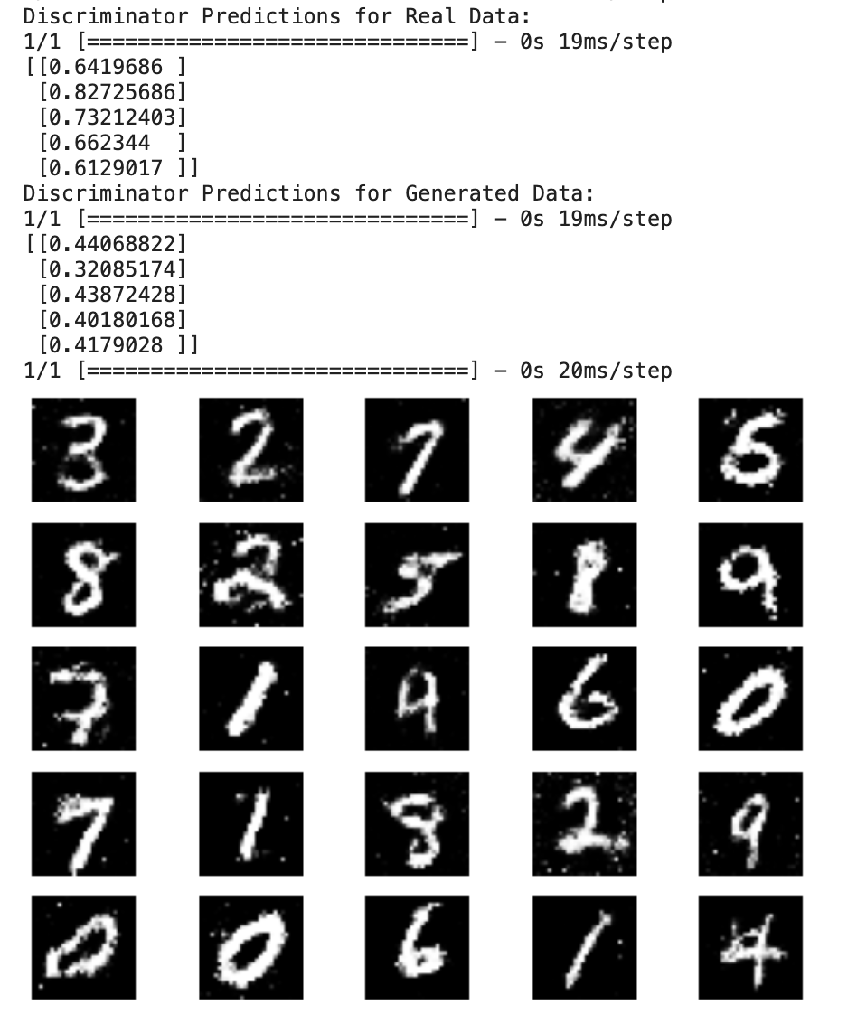

Slide 9
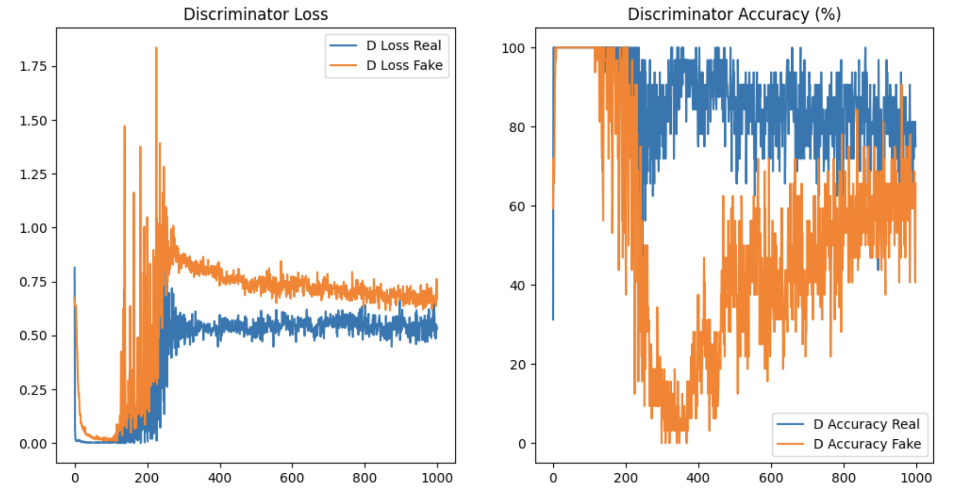

Slide 10
Noise Function
Gaussian (Normal) Noise: np.random.normal(mean, std, (batch_size, latent_dim))
Uniform Noise: np.random.uniform(low, high, (batch_size, latent_dim))
Poisson Noise: np.random.poisson(lam, (batch_size, gan.latent_dim))
Exponential Noise: np.random.exponential(scale, (batch_size, gan.latent_dim))
Laplacian Noise: np.random.laplace(loc, scale, (batch_size, gan.latent_dim))
Bernoulli Noise: np.random.binomial(1, p, (batch_size, gan.latent_dim))
Multiplicative Noise: np.random.uniform(lower_bound, upper_bound, (batch_size, gan.latent_dim))

Slide 11
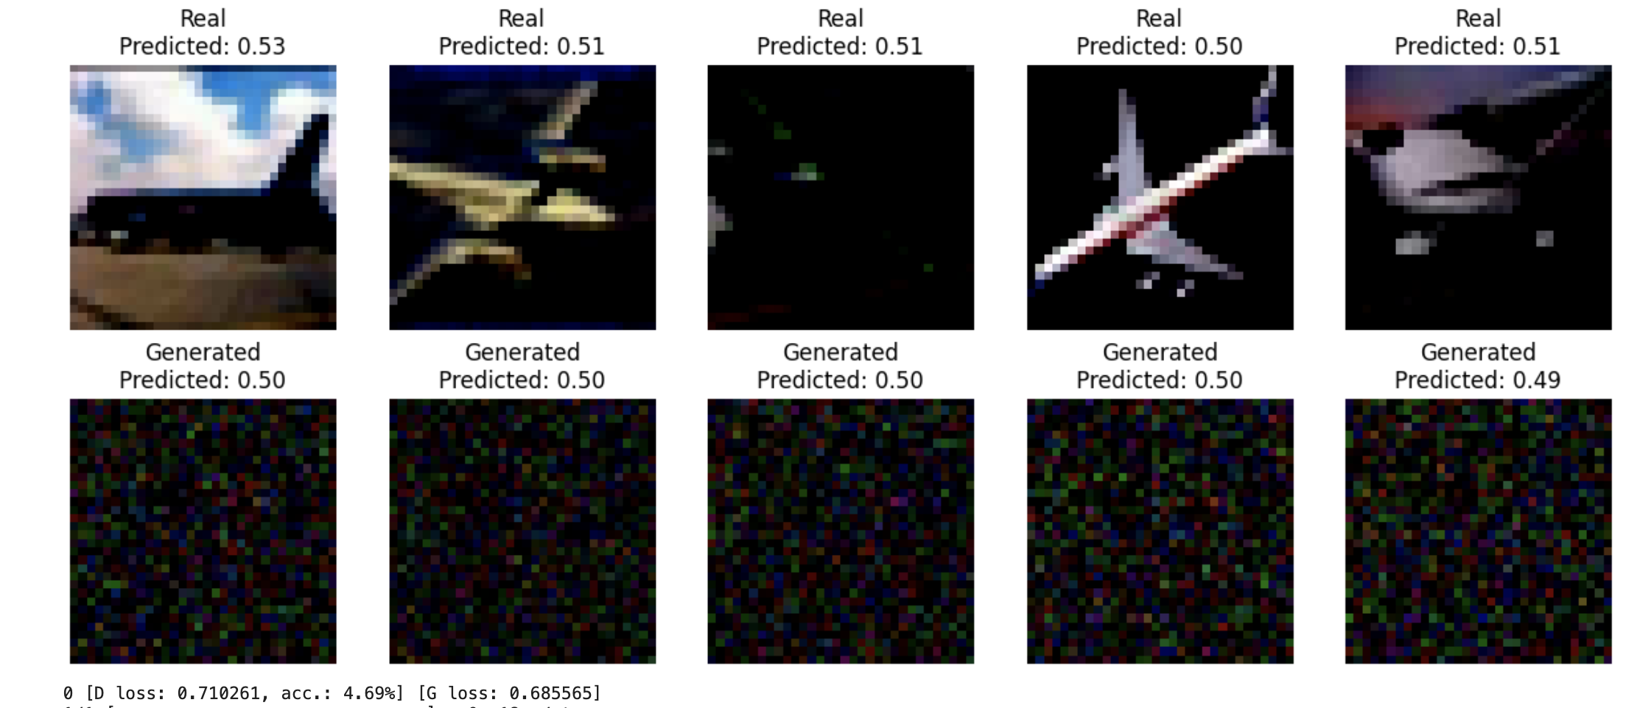
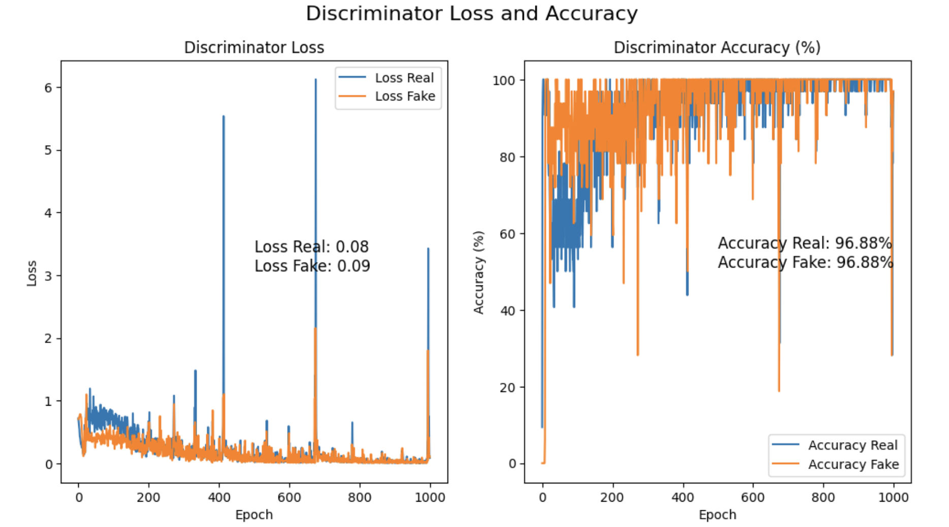
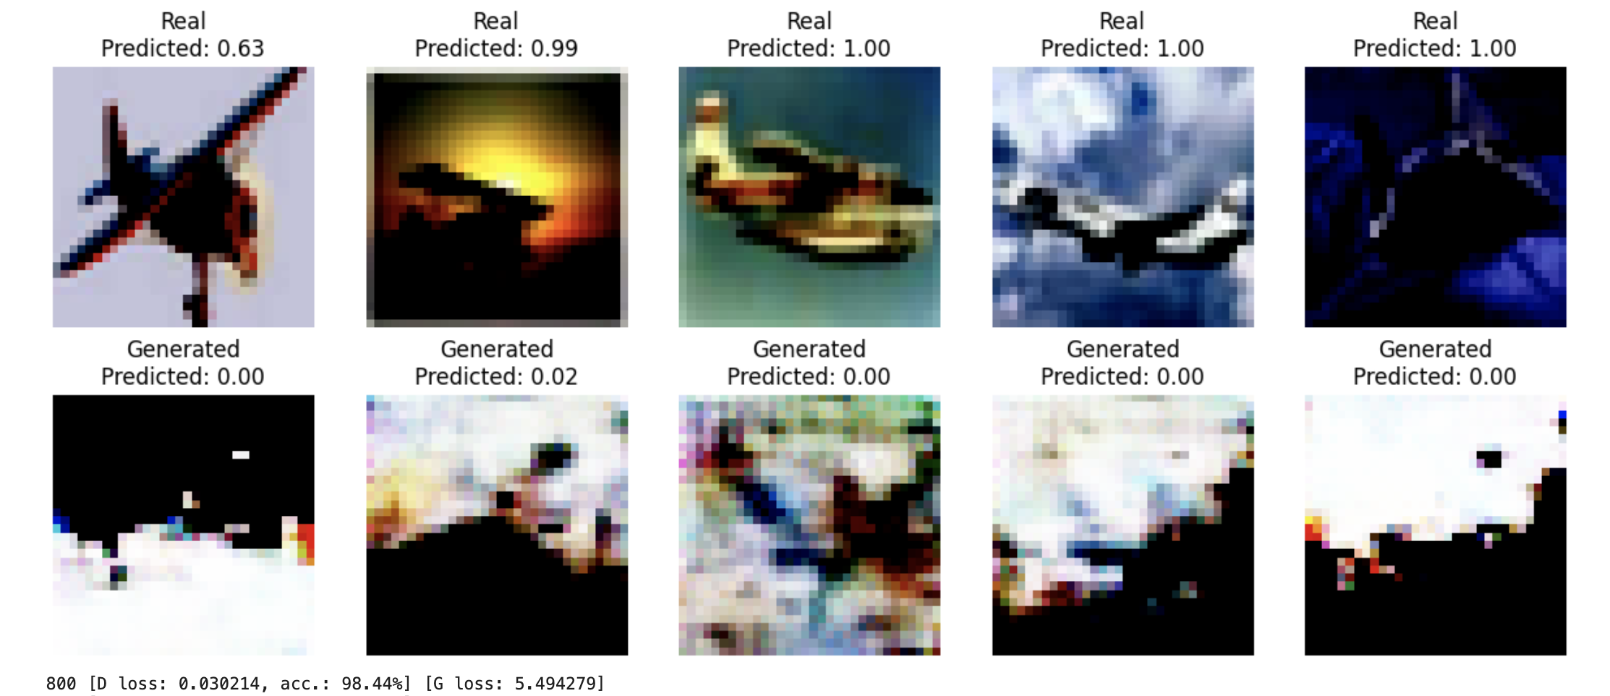
Epoch 1000

Slide 12
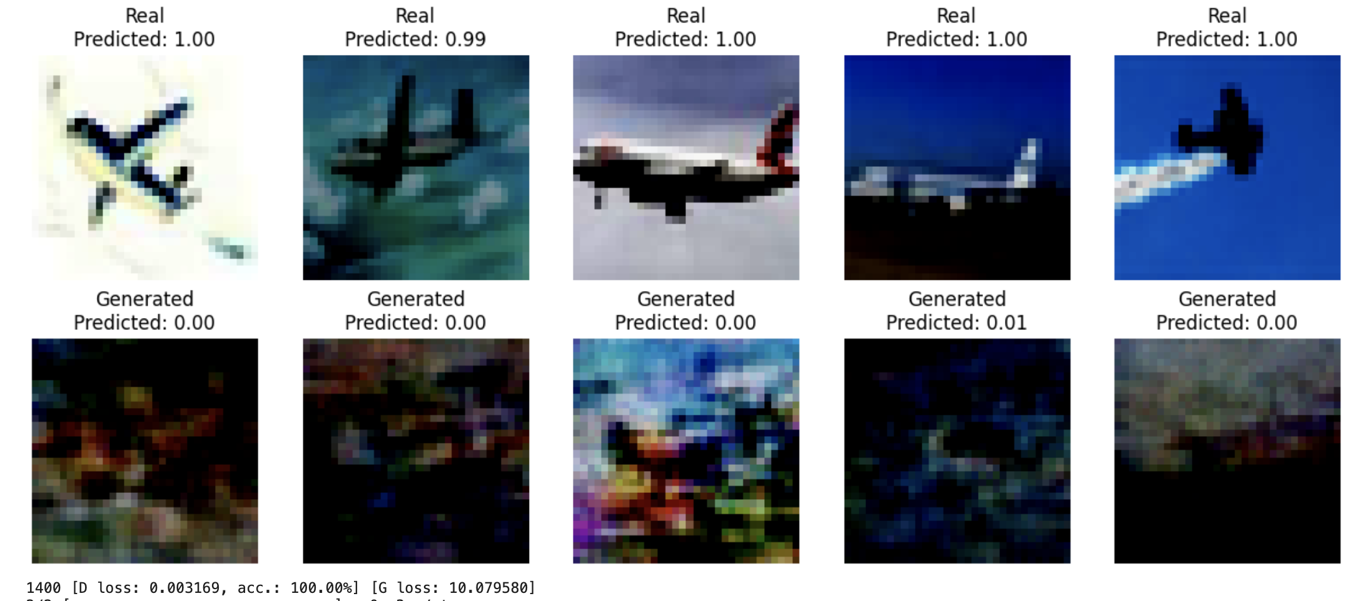
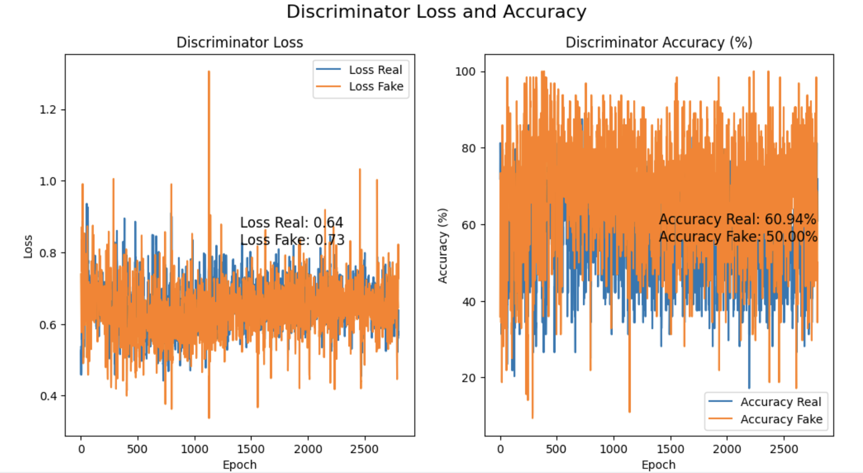
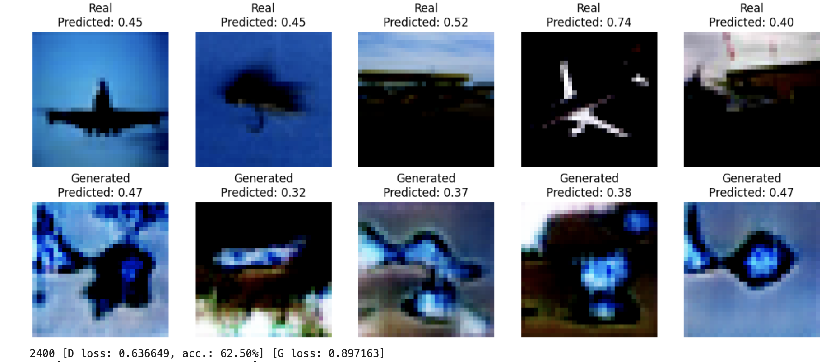
Epoch 3500

Slide 13
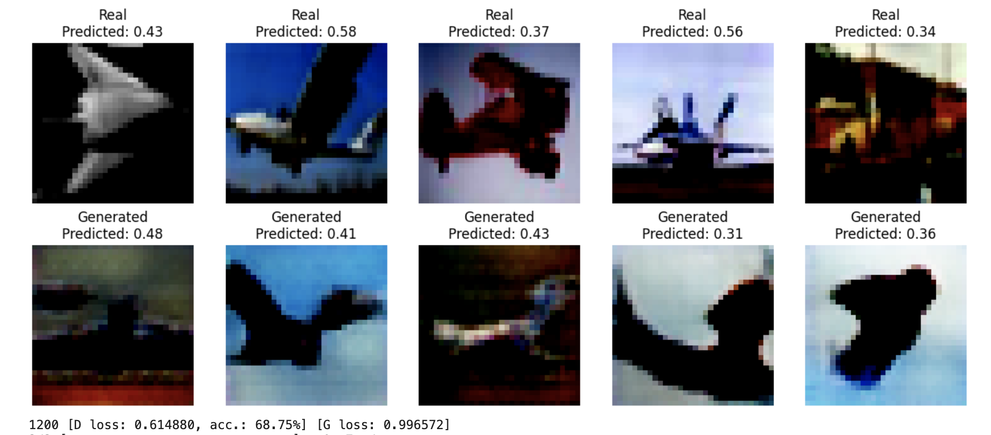
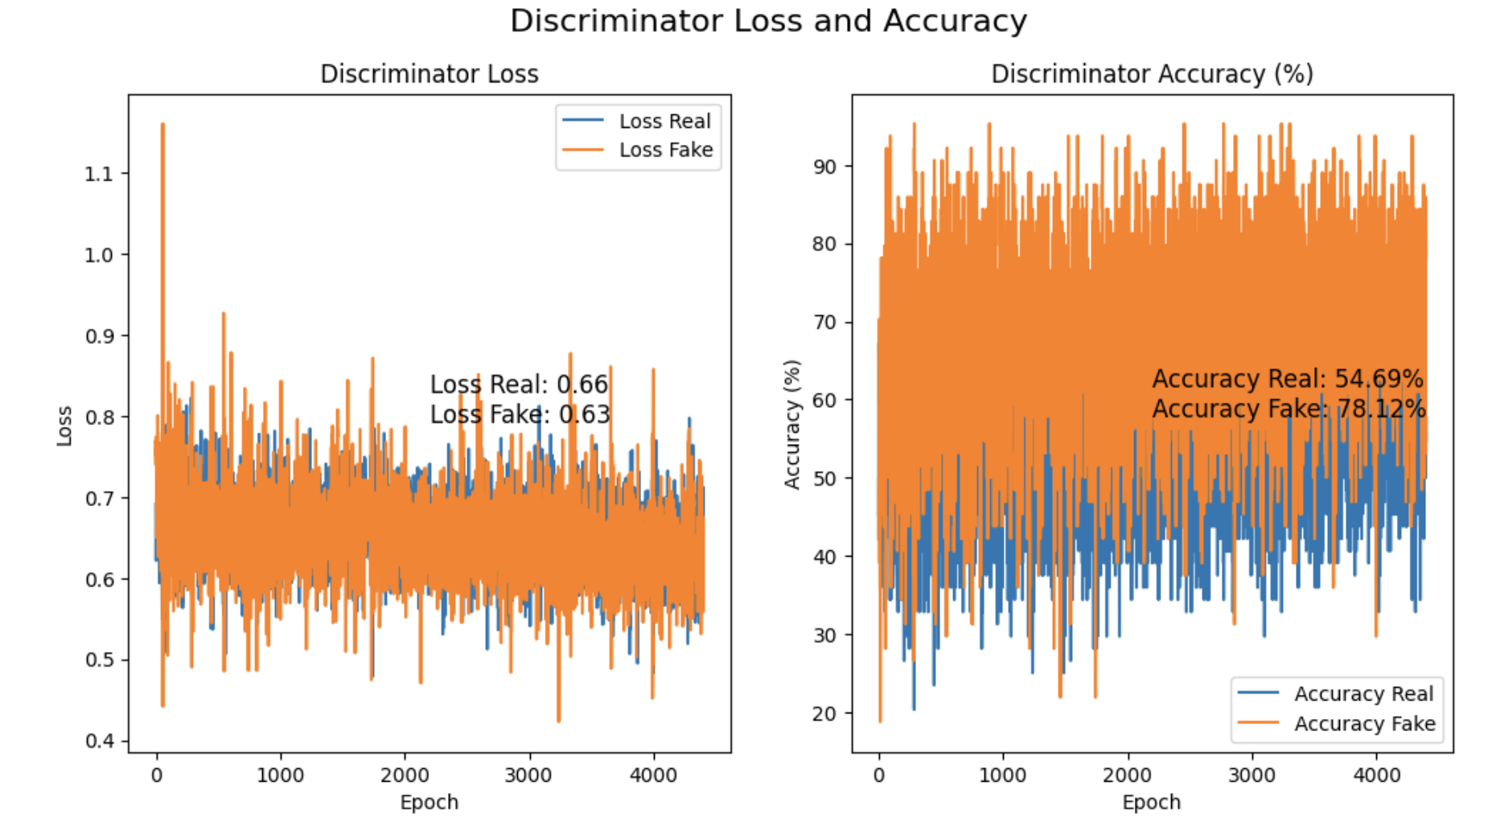
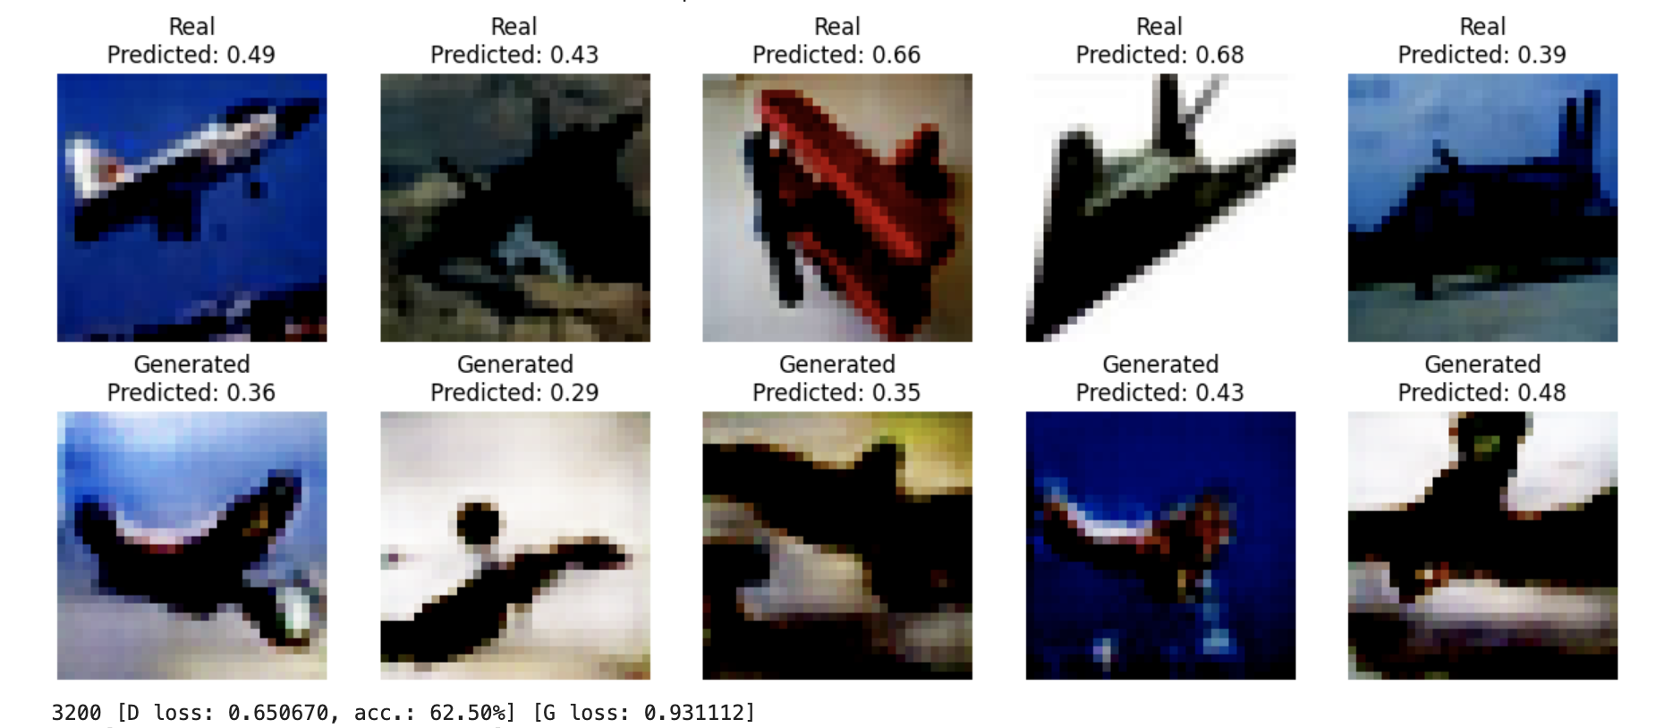
Epoch 5500

Slide 14
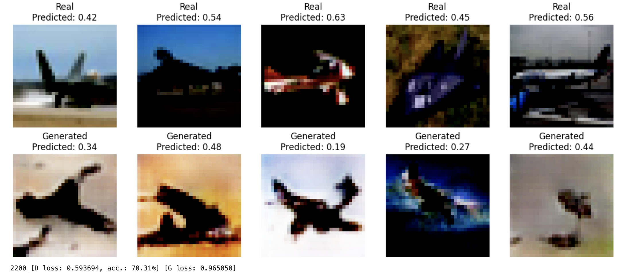
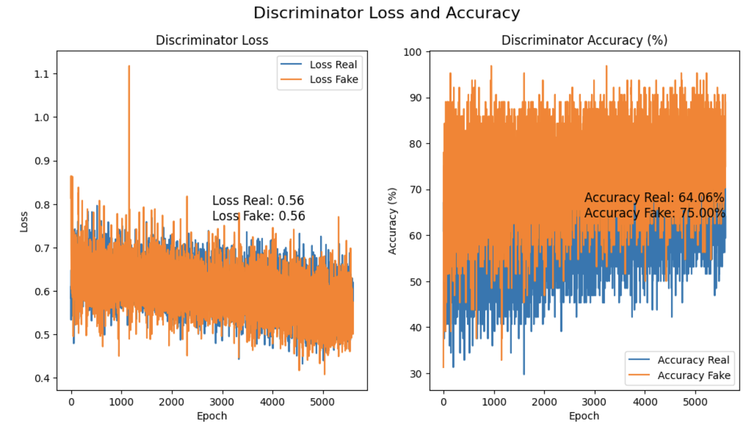
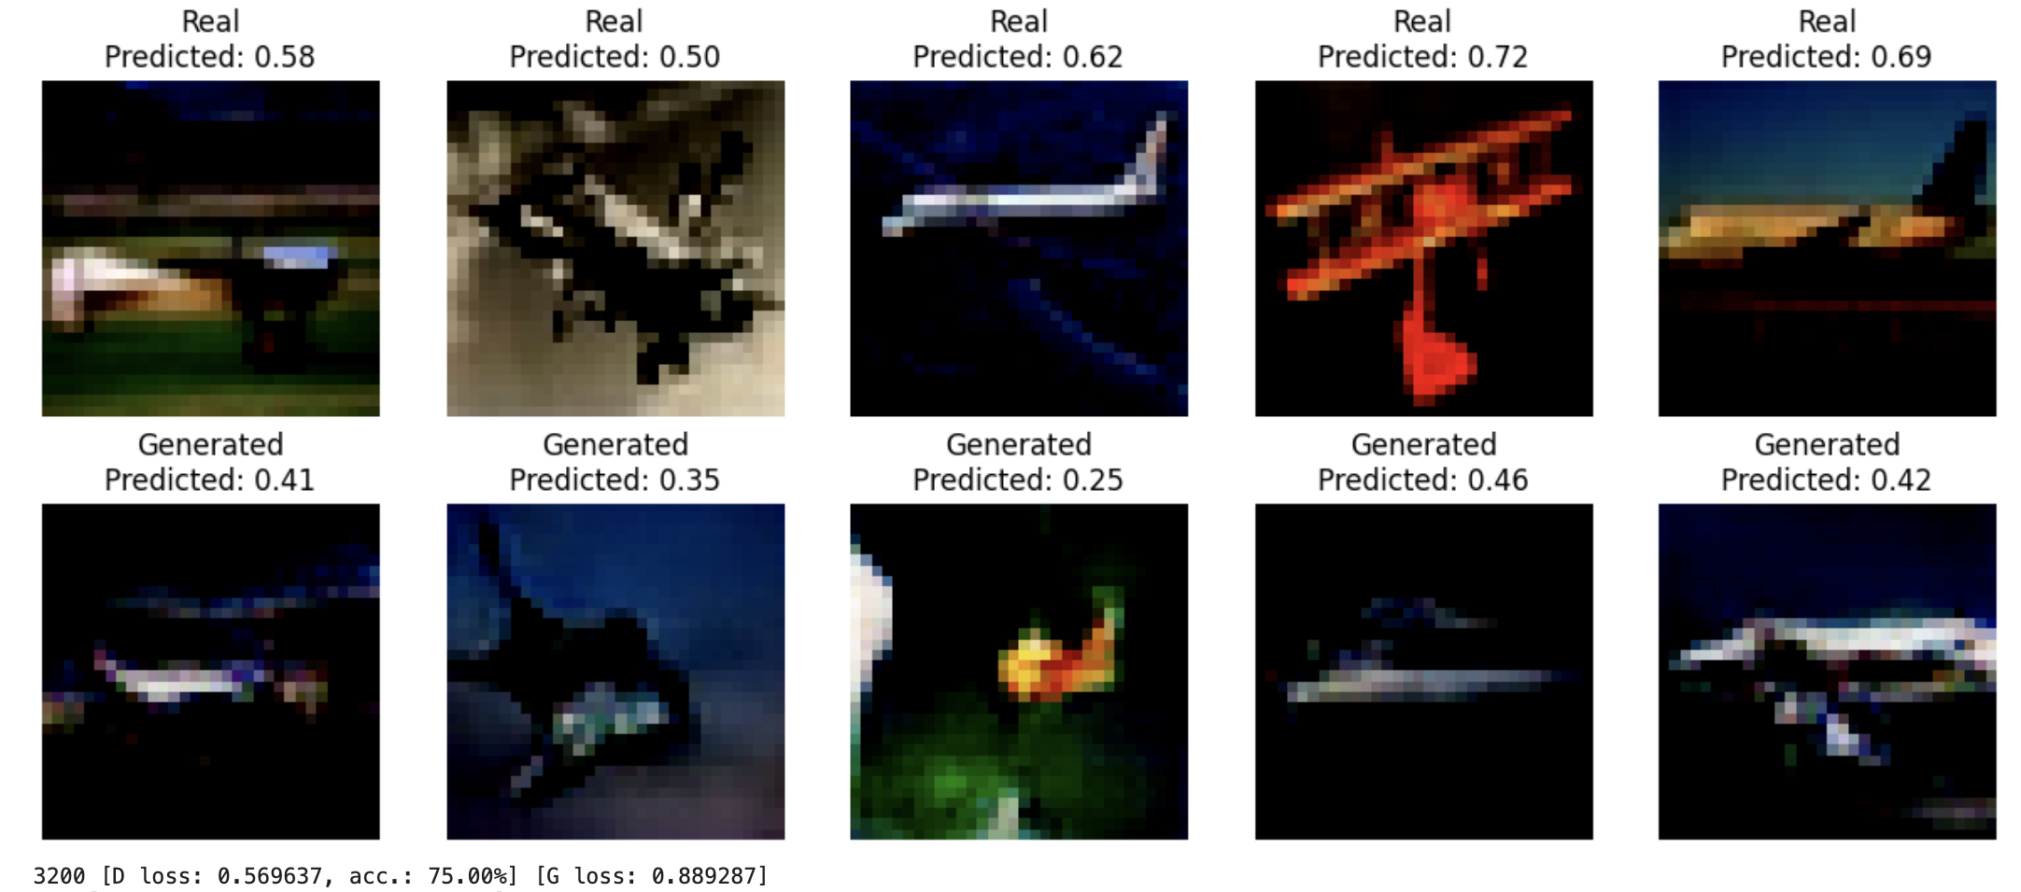
Epoch 7500

Slide 15
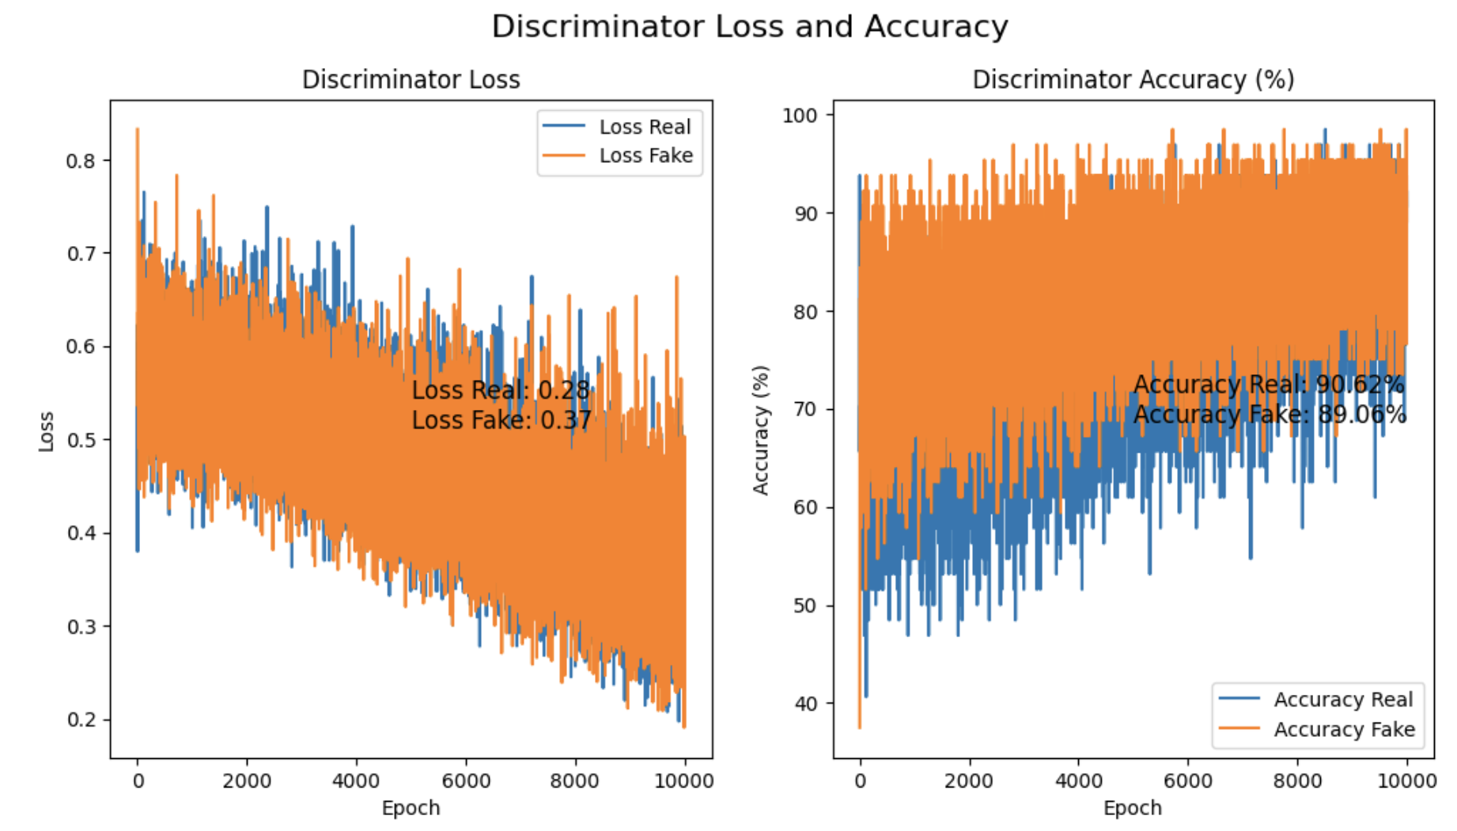
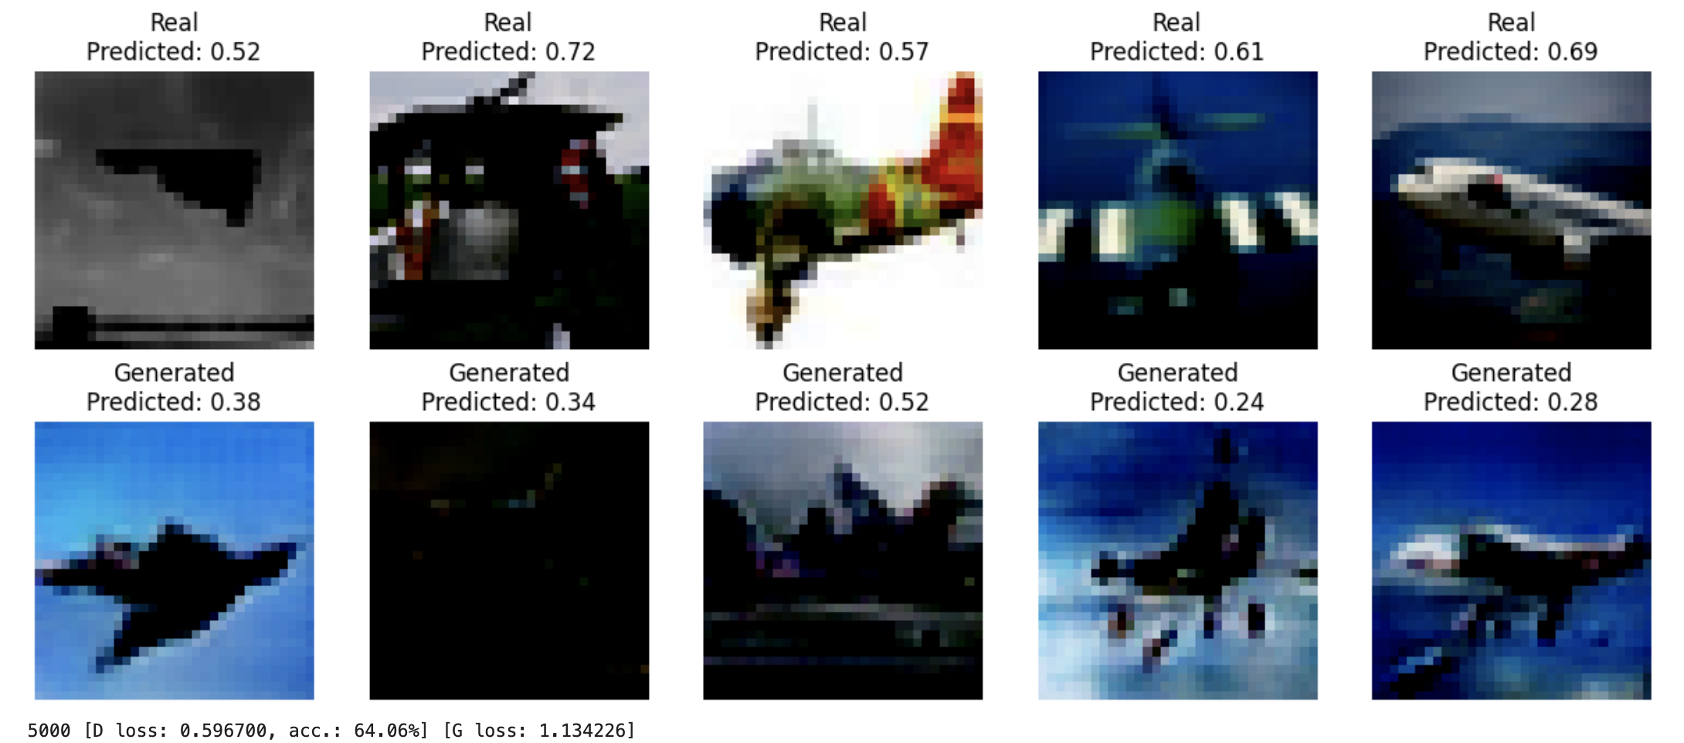
Epoch 15000

